Slide 1
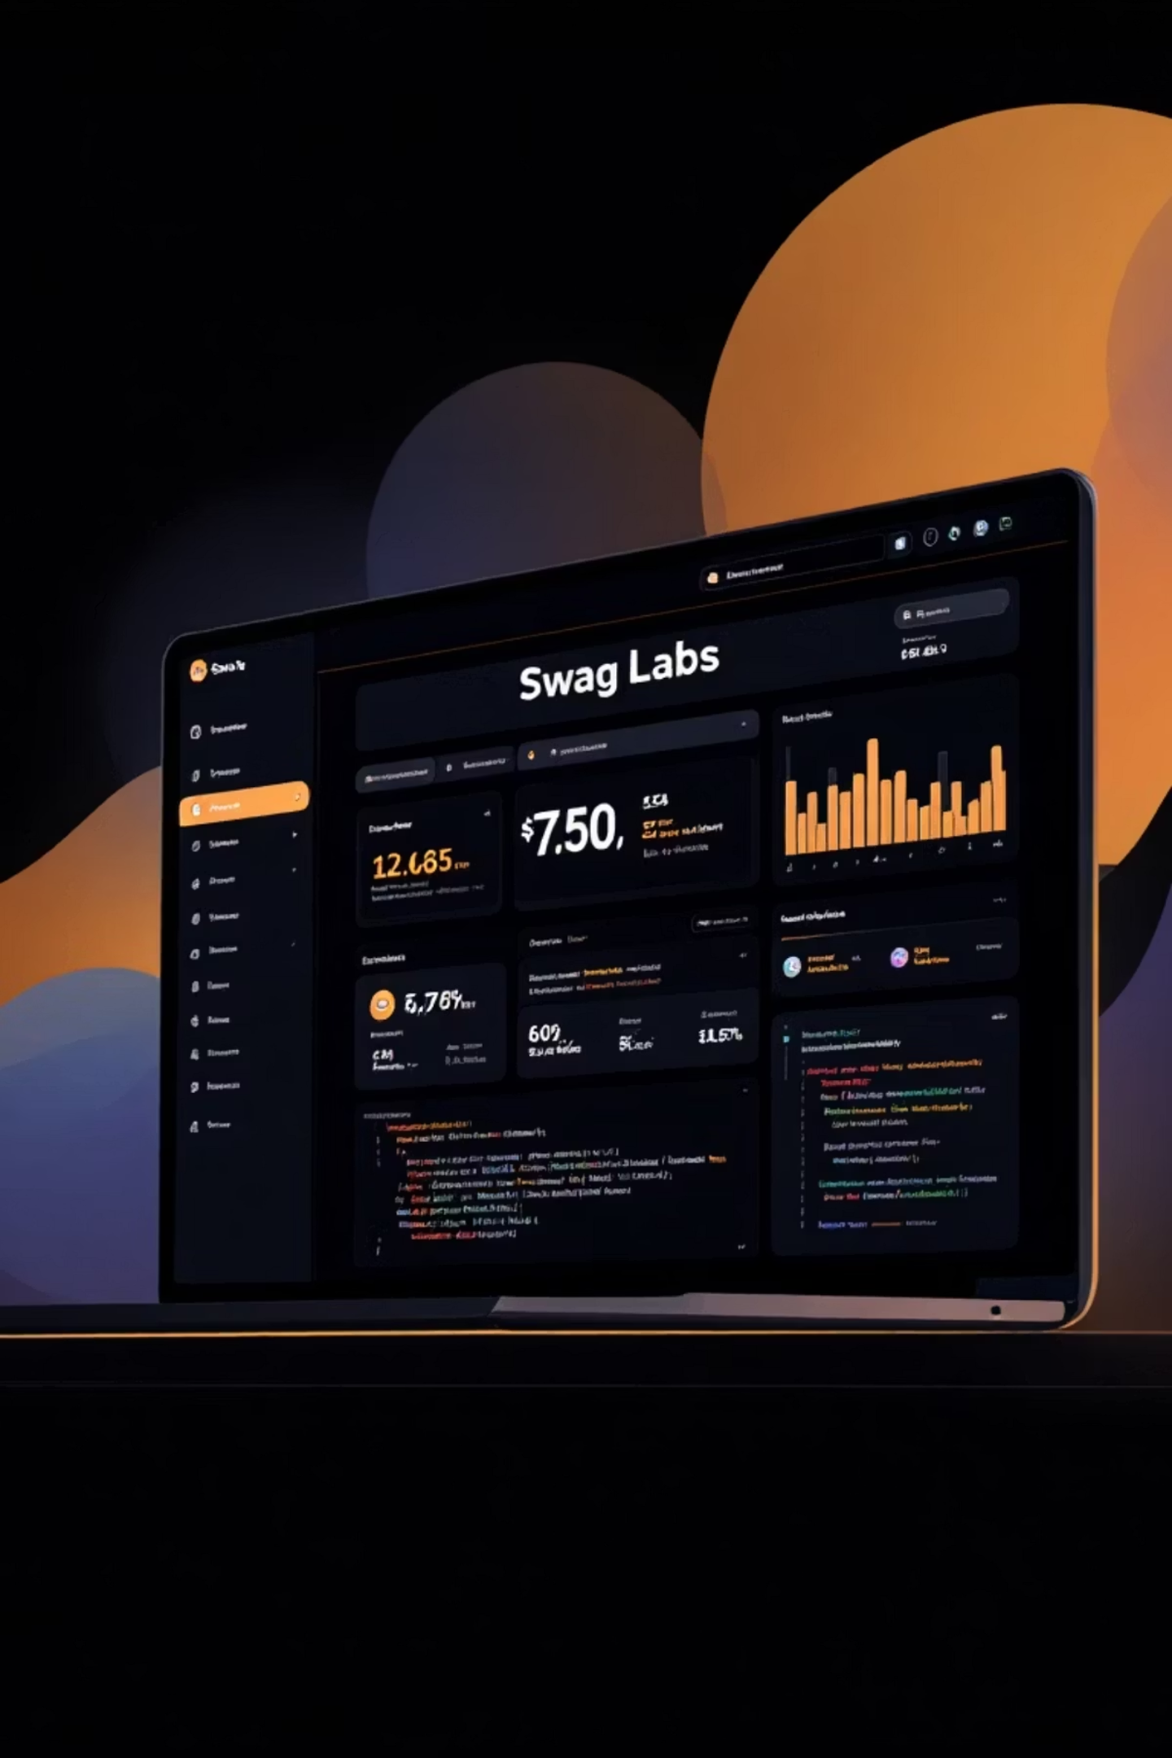

Swag Labs Automation Testing Project
A Complete End-to-End Testing Framework
Github url : https://github.com/Mahesh-521/Swag_Labs_project
Presented by: Banda Mahesh

Slide 2
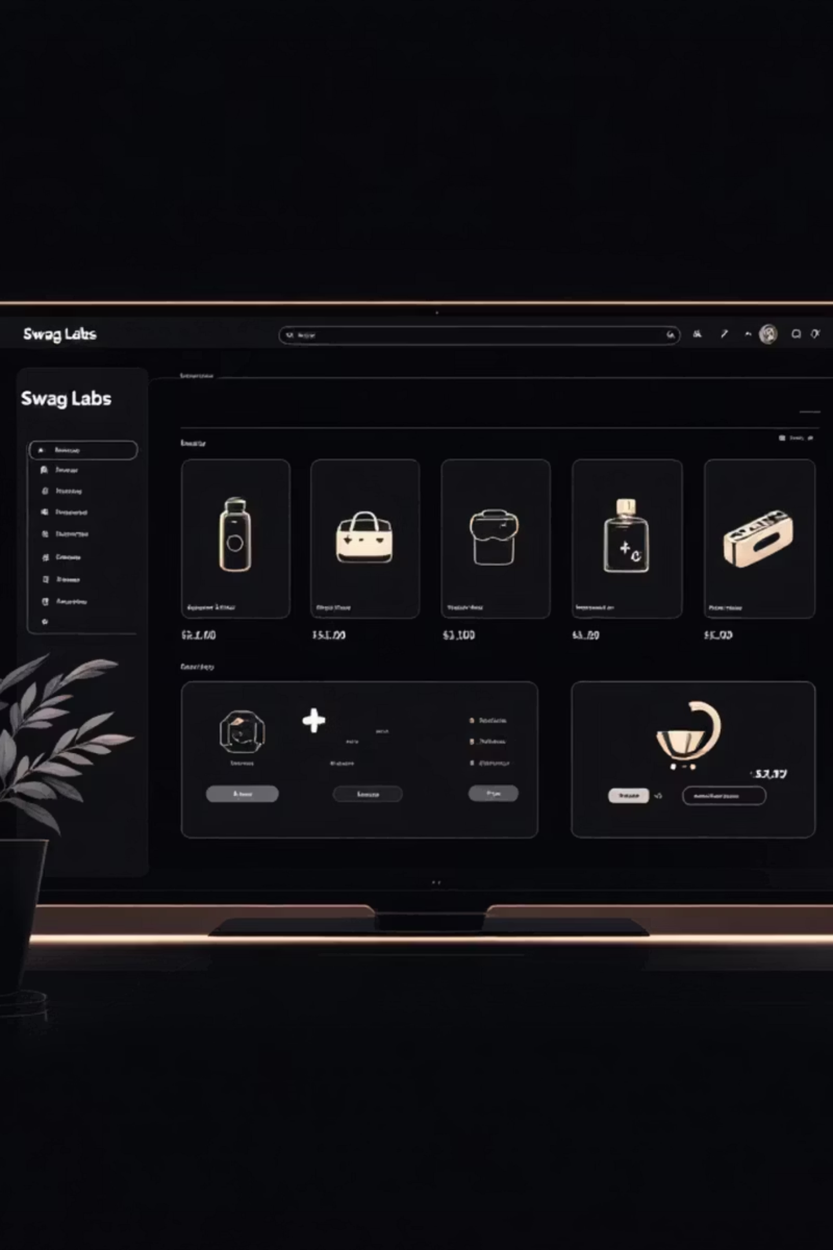
About Swag Labs Website
Swag Labs is a premier demo e-commerce site specifically designed for practicing robust automation testing scenarios. It provides a realistic environment to simulate user interactions.
URL: https://www.saucedemo.com
The site supports a full e-commerce workflow including secure login, intuitive product browsing, adding items to a shopping cart, a streamlined checkout process, and final order placement. It's an ideal platform for QA engineers and automation testers to Test their skills.

Slide 3
Project Overview
Technology Stack
Architecture
Developed using Java, Selenium WebDriver, TestNG, and Maven, integrated with Jira for issue tracking and Jenkins for continuous integration.
The framework implements the Page Object Model (POM) for a modular, maintainable, and scalable test structure. This ensures code reusability and reduces duplication.
Features
Coverage
Includes robust utilities for data-driven testing, allowing test scenarios to run with multiple data sets, and Extent Reports for detailed, interactive test reporting.
Provides comprehensive end-to-end test coverage for all major functional flows within the Swag Labs application, from user authentication to order completion.

Slide 4
Features Implemented
User Authentication
Shopping Experience
Thorough login validation for both valid and invalid credentials.
Product selection, filtering, sorting, and seamless cart management.
Purchase Flow
Error Handling
Comprehensive validation of the entire checkout process.
Automated screenshot capture upon test failure for quick debugging.
Test Flexibility
Documentation
Data-driven testing capabilities using external Excel files.
Detailed and customizable test reporting via Extent Reports.

Slide 5
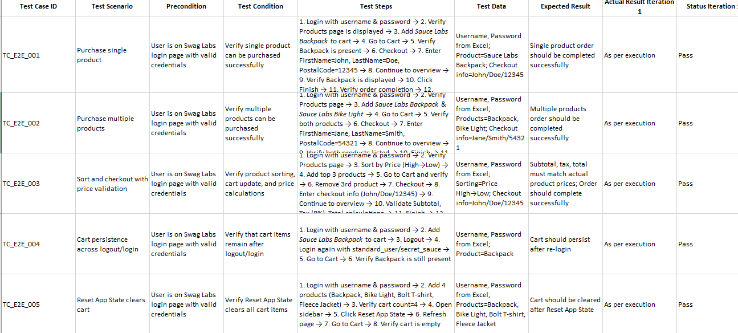
Manual Test Cases:

Slide 6
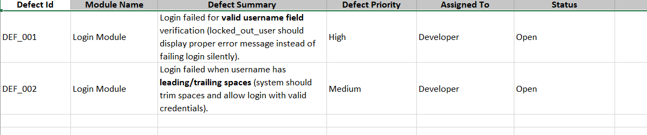
Defect Reporting :

Slide 7
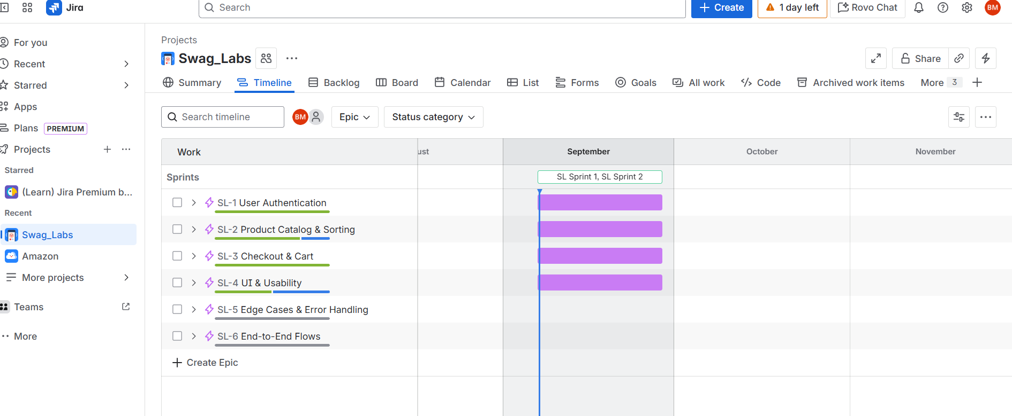
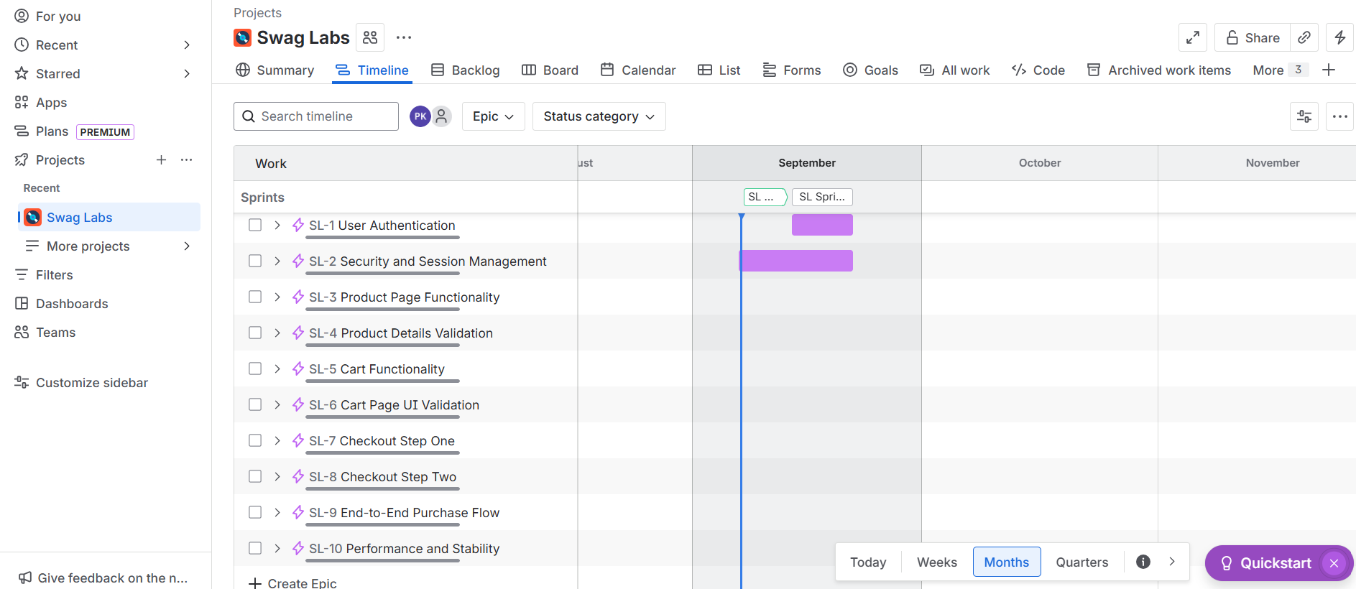
Results of Jira Epic’s and Stories:

Slide 8
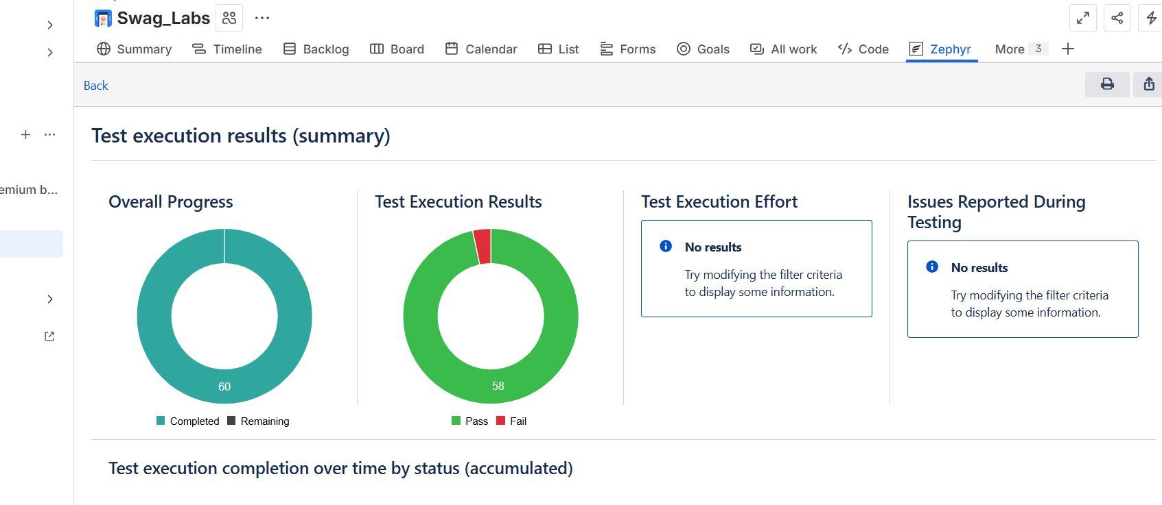
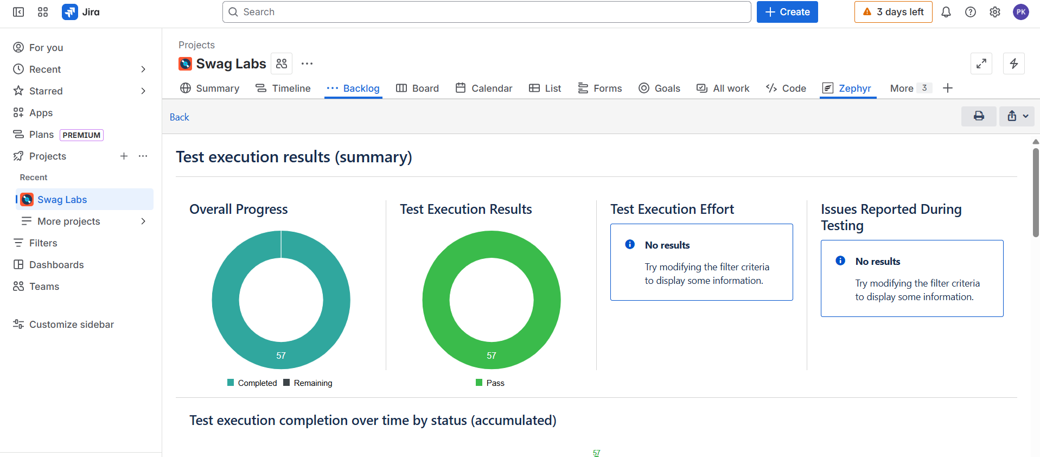
Results of Report in Jira:

Slide 9

Automation Approach: A Strategic Framework
01
Page Object Model (POM)
Test scenarios are cleanly mapped to reusable page classes, abstracting web elements and interactions, ensuring maintainability.
02
Data Management
A robust data-driven approach leveraging Excel files for diverse and flexible input values across test cases.
03
Debugging & Traceability
Integrated logging and automated screenshots on failure provide clear insights for quick and efficient debugging.
04
CI/CD Integration
Seamless continuous integration via Jenkins, enabling scheduled and automated test runs for rapid feedback.

Slide 10
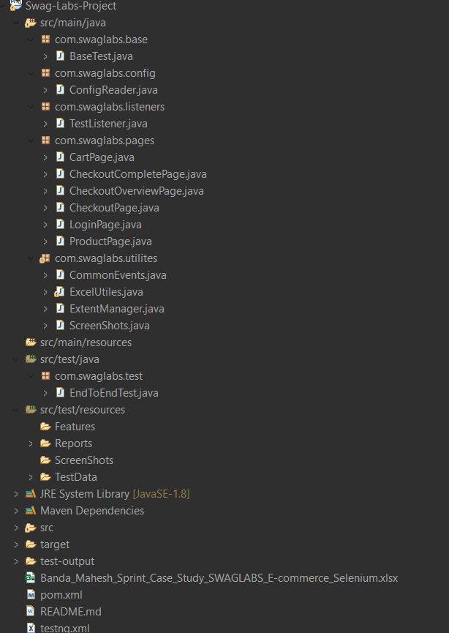
Project Structure: Organized for Clarity
Swag-Labs-Project/
├── src/
│ ├── main/
│ │ ├── java/
│ │ │ └── com/
│ │ │ └── swaglabs/
│ │ │ ├── base/
│ │ │ ├── config/
│ │ │ ├── listeners/
│ │ │ ├── pages/
│ │ │ └── utilities/
│ │ └── resources/
│ │ └── config.properties
│ └── test/
│ ├── java/
│ │ └── com/
│ │ └── swaglabs/
│ │ └── test/
│ └── resources/
│ ├── testdata/
│ │ └── login.xlsx
│ ├── reports/
│ │ └── swaglabsreport.html
│ └── screenshots/
├── target/
├── test-output/
├── pom.xml
├── testng.xm;

Slide 11
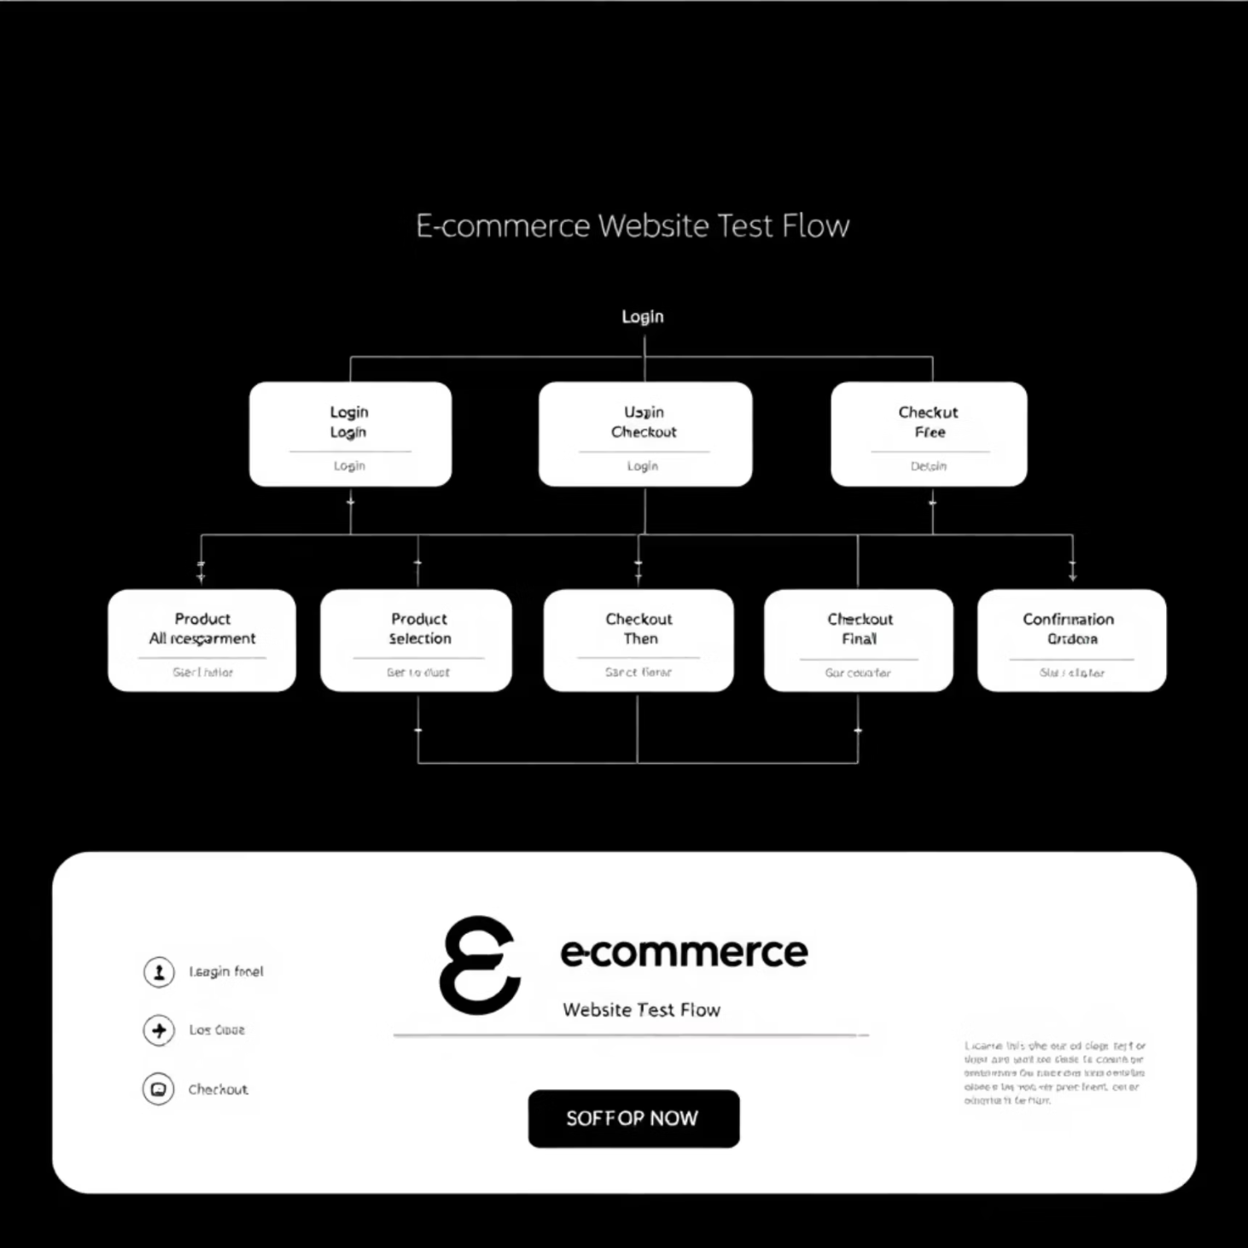
End-to-End Test Cases: Ensuring Full Coverage
The Swag Labs automation project provides robust end-to-end coverage for critical user flows, ensuring application stability and functionality.
Login with valid/invalid credentials
Add single/multiple products to cart
Apply sorting and verify results (A-Z, Z-A, price low-high, high-low)
Checkout process validation
Cancel checkout and verify redirection
Cart persistence after logout and re-login
Complete purchase flow with order confirmation

Slide 12




Integration & Reporting
Reports and Logging
Jenkins Integration
Extent Reports integrated for interactive dashboards
Used Freestyle project to automate test execution
Logs capture each test step with timestamp and status
Configured build steps to run Maven commands and execute TestNG tests
Screenshots taken for failures for better debugging
Test results and reports archived as build artifacts
Reports archived in test directories for historical reference
Scheduled periodic test runs using Jenkins triggers
Jira Implementation
Test Results & Conclusion
Test cases tracked as issues for transparency
All major test cases passed successfully
Defects linked to test execution results
Reports generated with detailed logs and screenshots
Sprint planning and defect management integrated with test reporting
The Swag Labs Automation Project provides a robust framework for web testing
Helps teams collaborate and prioritize tasks effectively
Enhances testing accuracy, efficiency, and scalability

Slide 13
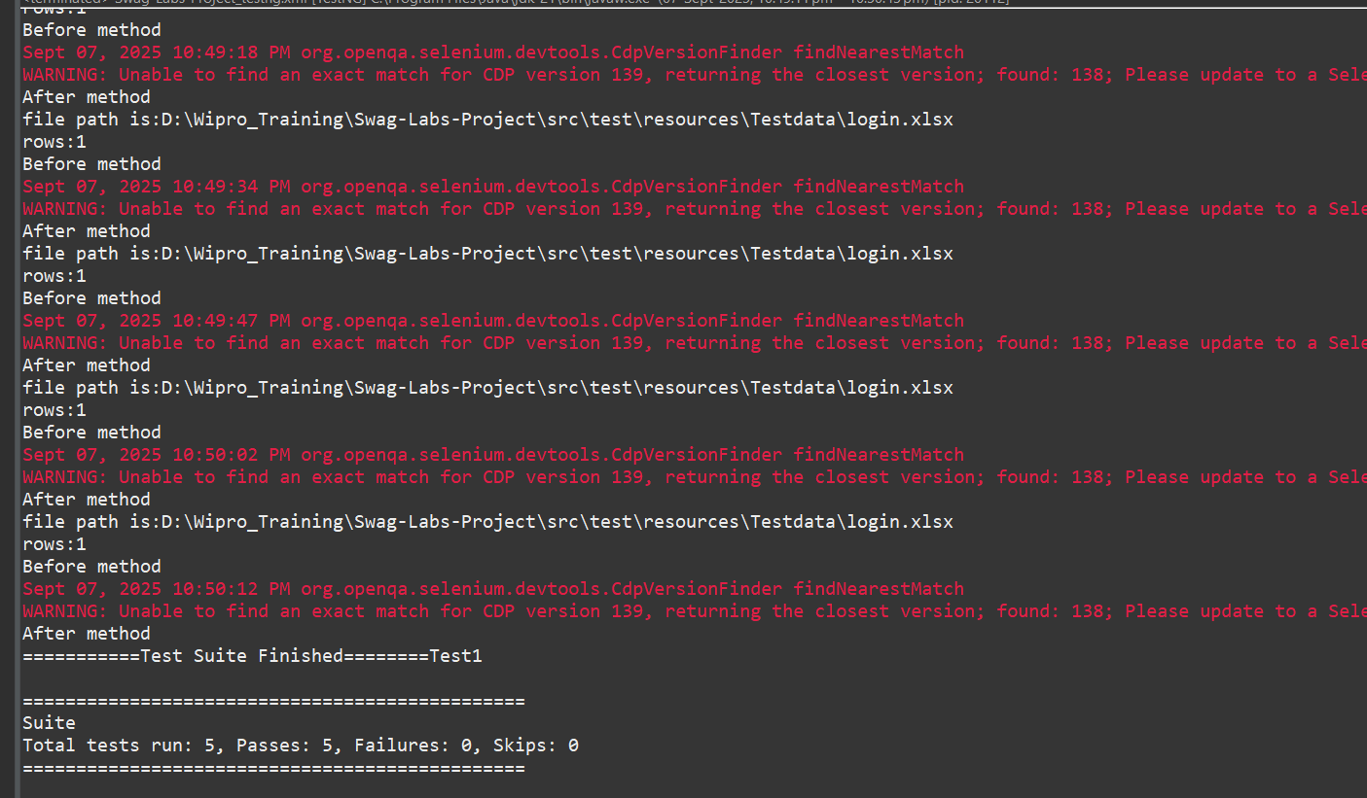
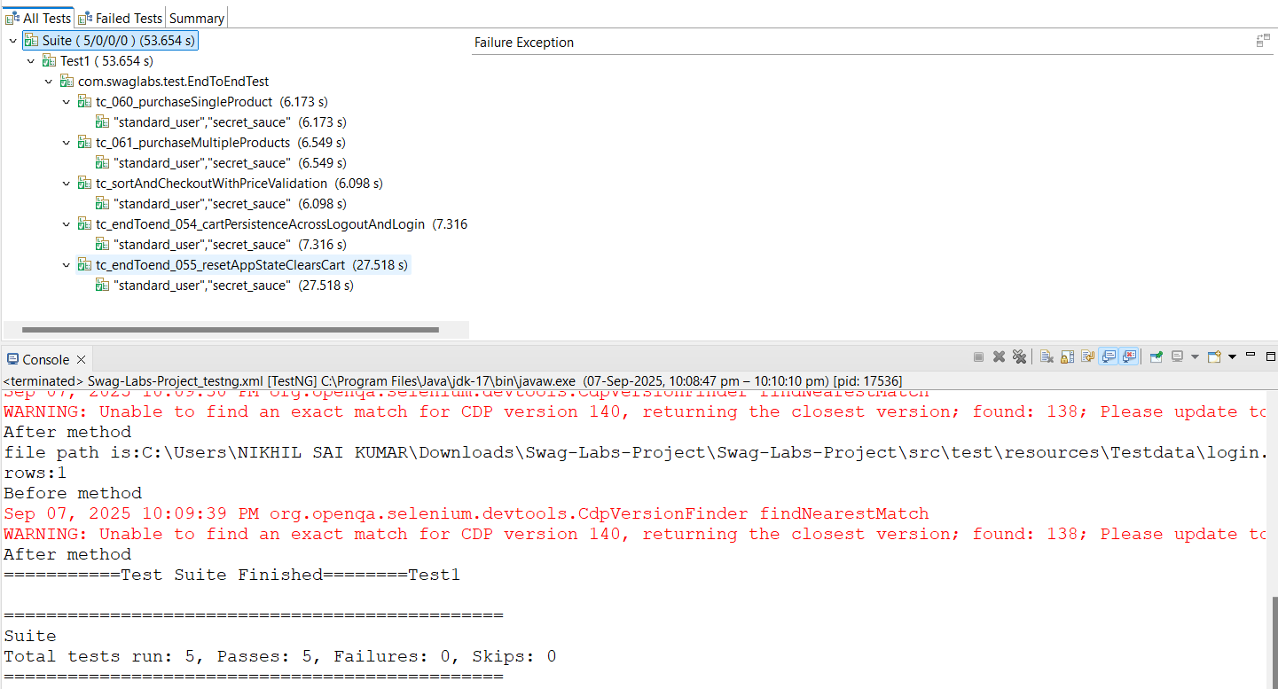
Results of TestNg:
Results:

Slide 14
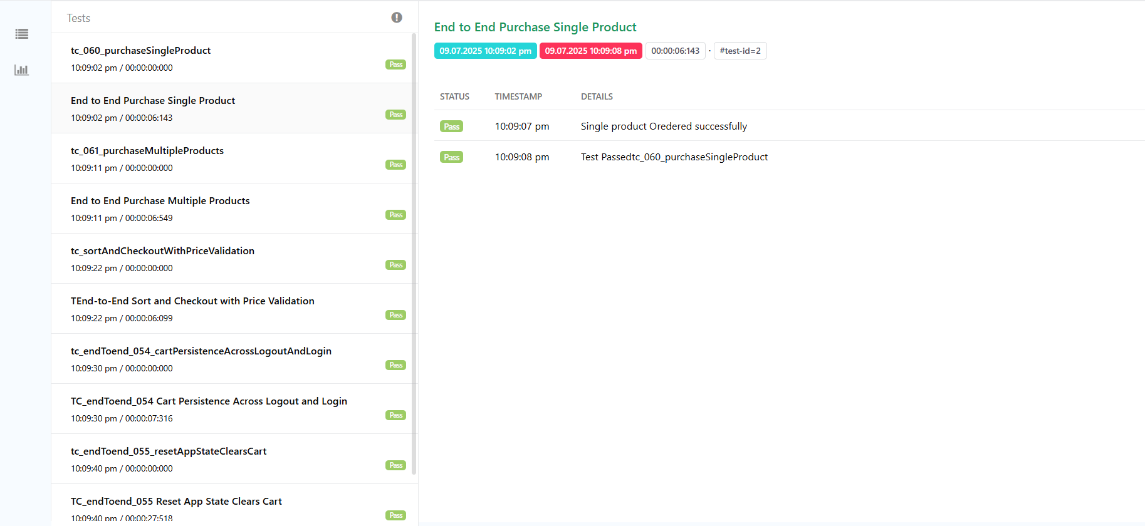
Results of Extent Report:

Slide 15
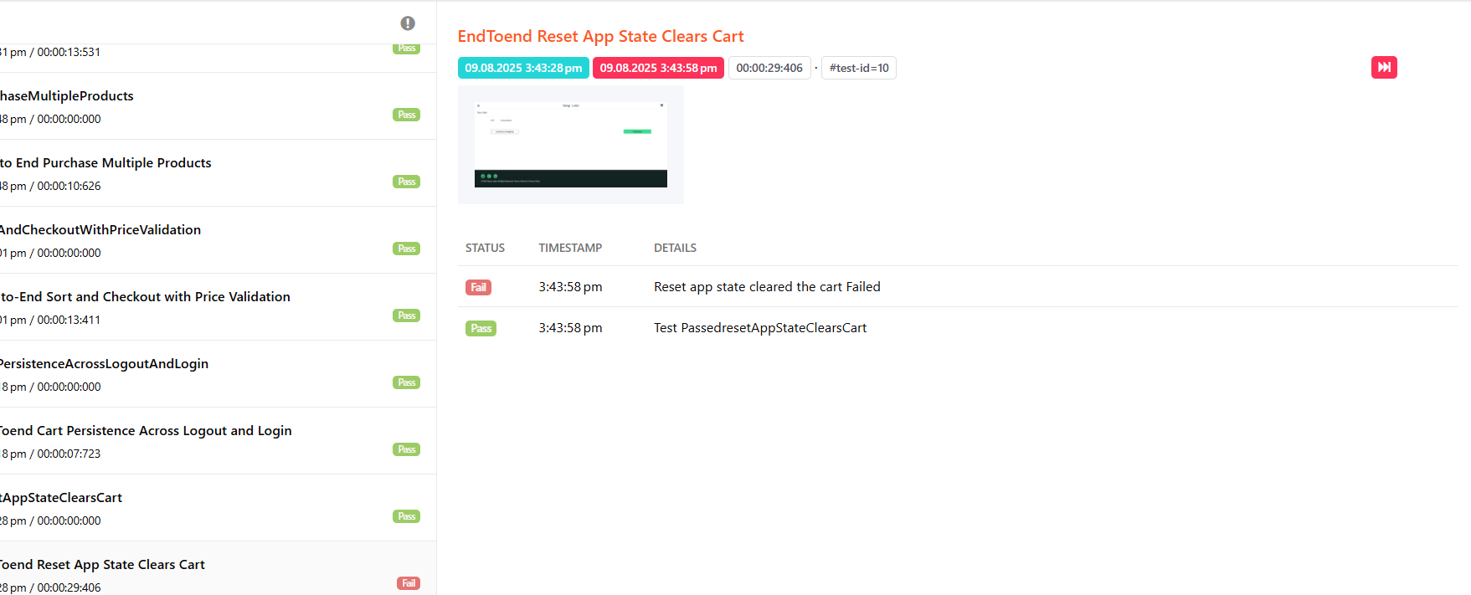
Failed Case :

Slide 16
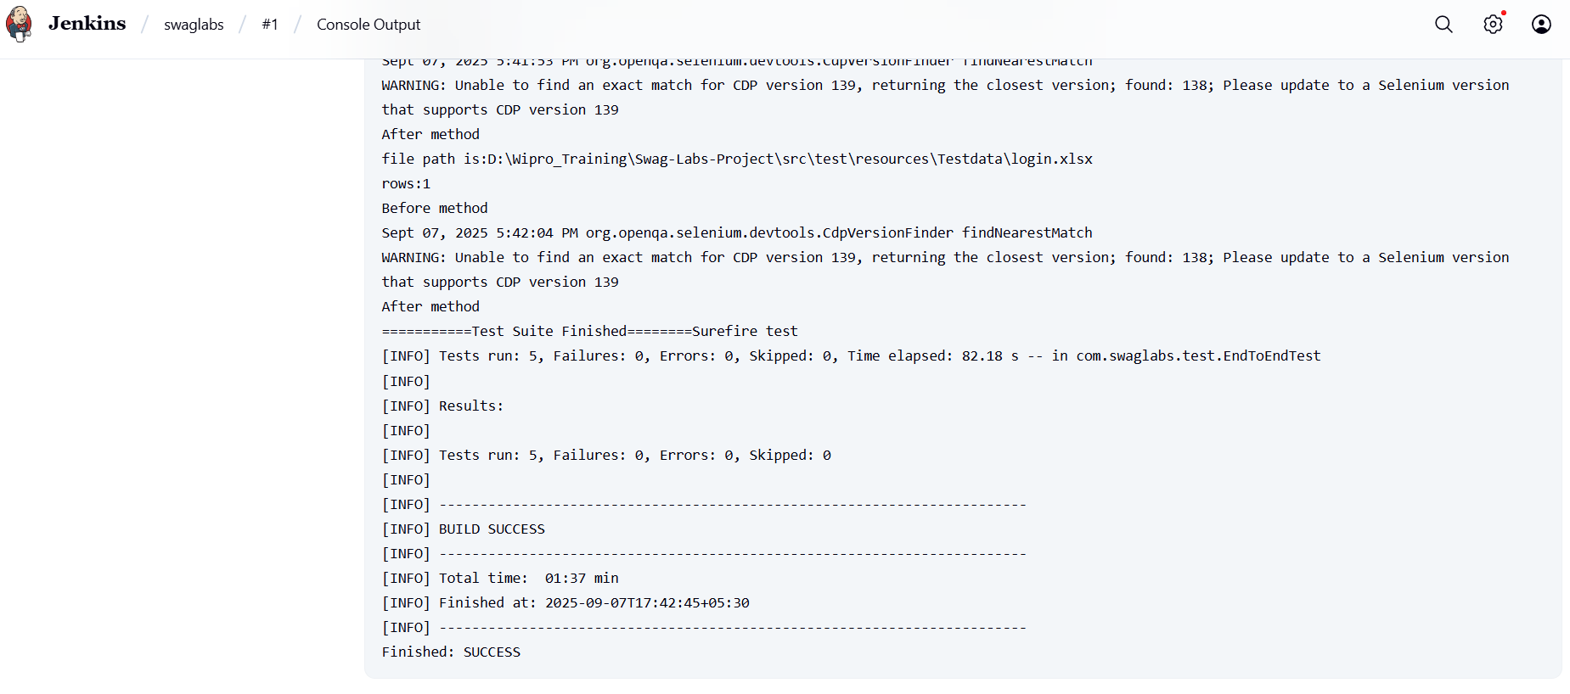
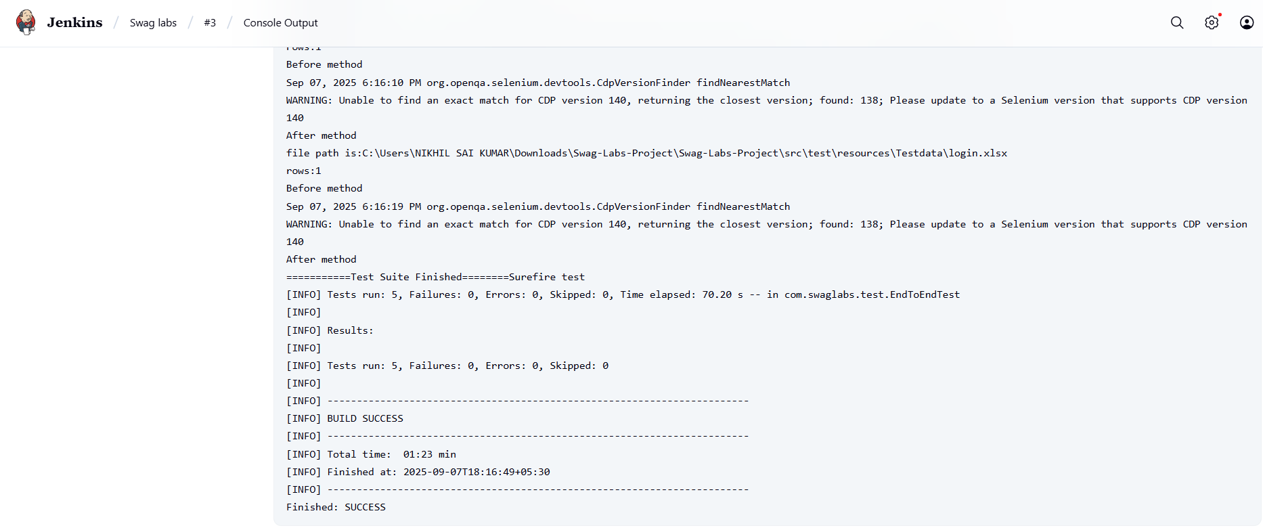
Results of Jenkins:

